Slide 1

English for Telephoning
Class: 18C1-NNA1
Time: 14.10 – 15.40 on
Lecturer: Ms. Nguyen Thi Thanh Tu
Faculty of Foreign Languages
Ly Tu Trong College of Ho Chi Minh City
Unit 2: Could you spell that for me? (cont.)

Slide 2
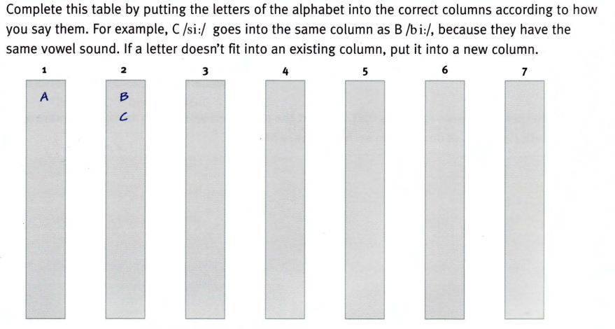
6. Do you know how to say the alphabet in English?

Slide 3
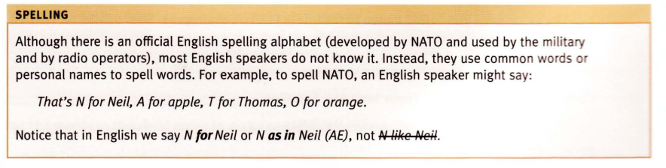
Learn the alphabet in English through songs.

Slide 4
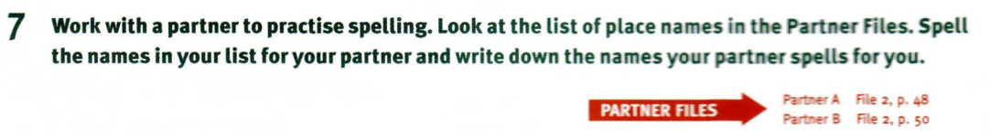
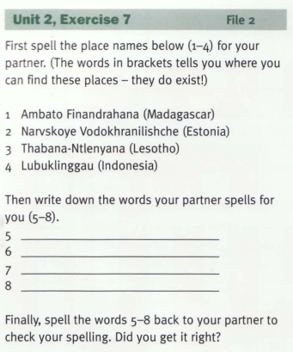
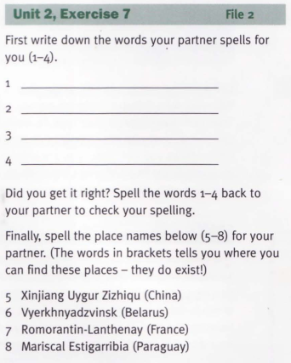
Partner A
Partner B

Slide 5
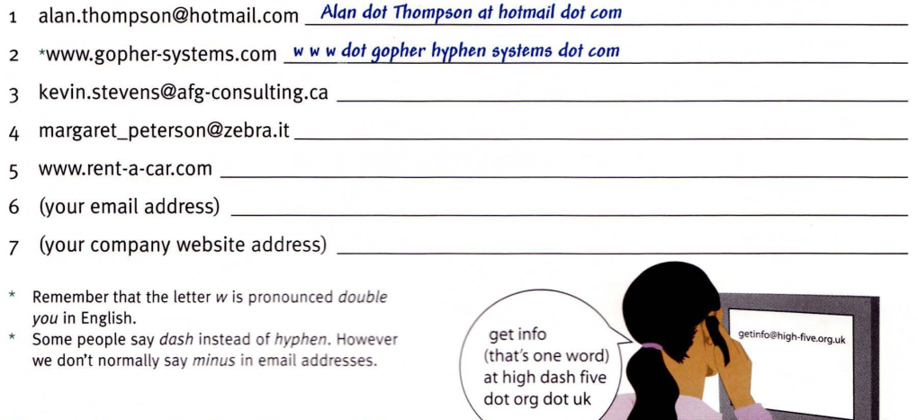
8. Write the email and website addresses in words, as in the examples.
Now practise reading the addresses out loud.

Slide 6
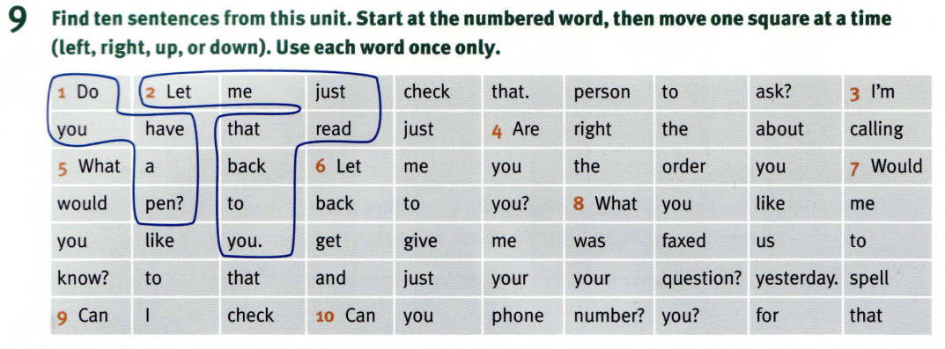

Slide 7
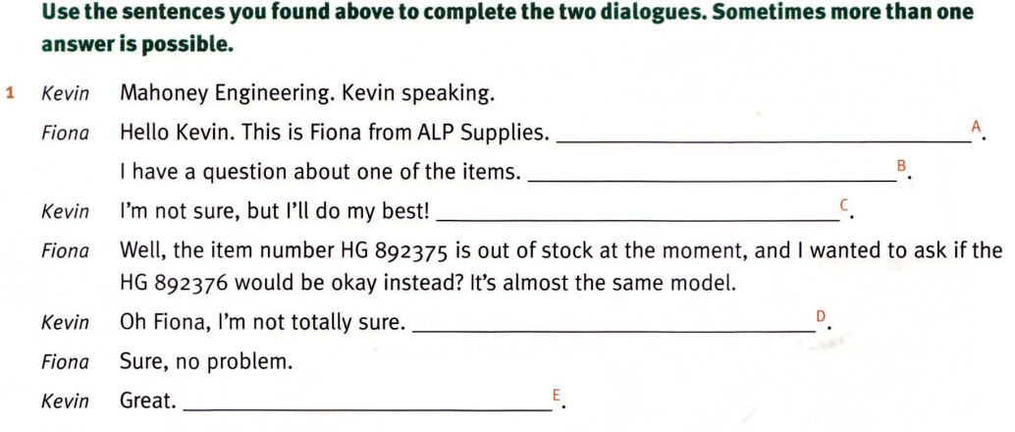
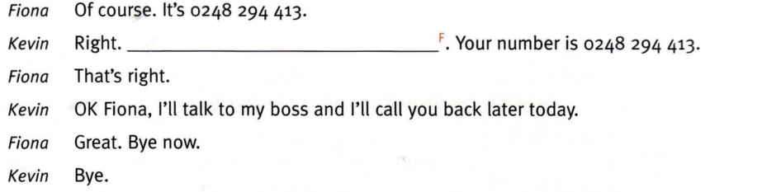

Slide 8
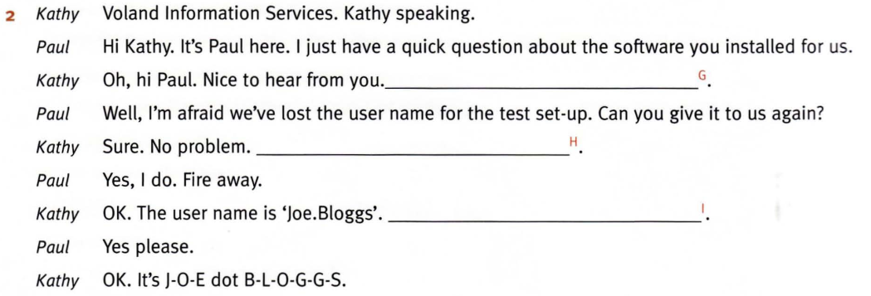
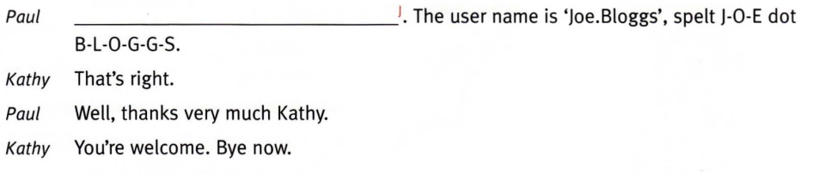

Slide 9
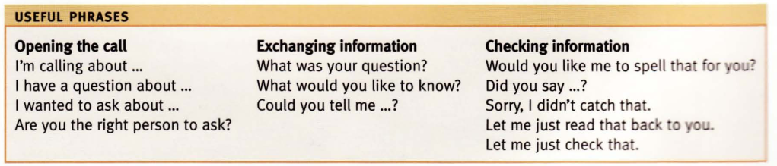

Slide 10
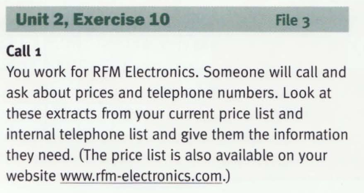
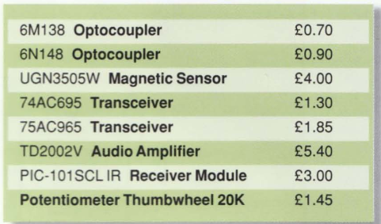
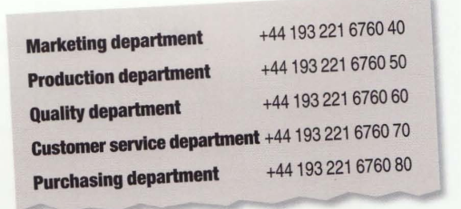
Partner A:

Slide 11
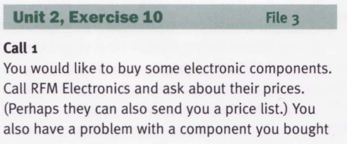
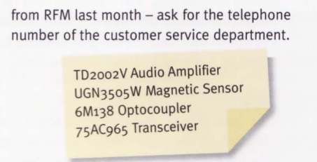
Partner B

Slide 12
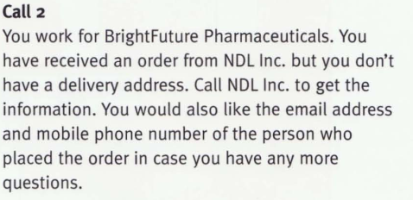
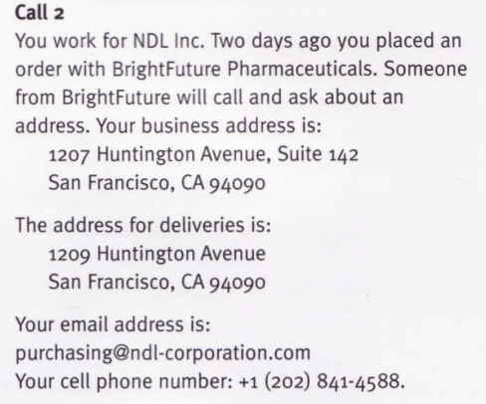
Partner A
Partner B

Slide 13
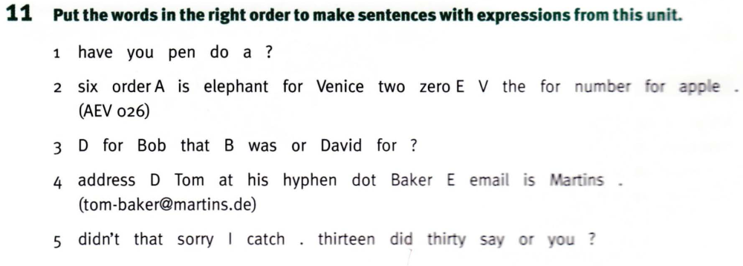

Slide 14
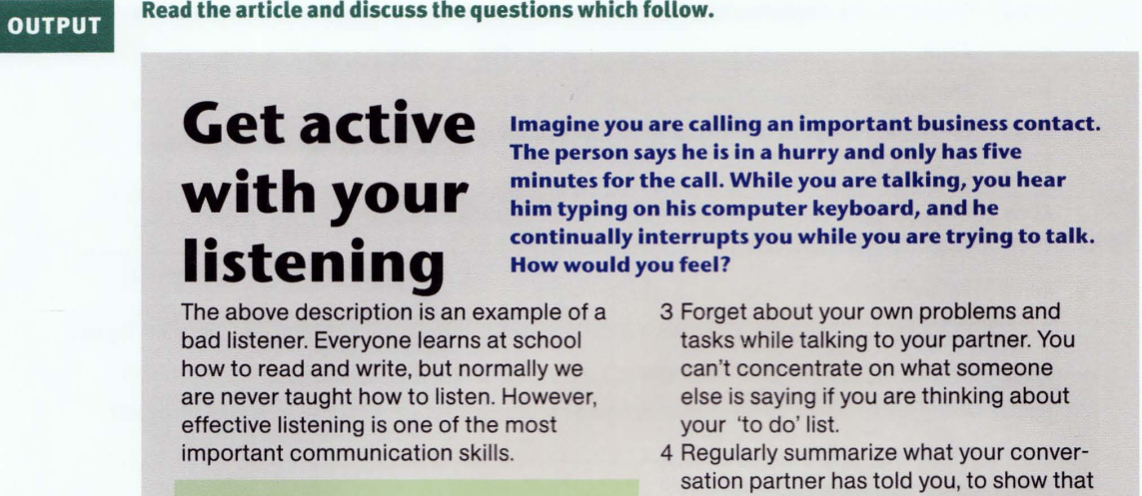

Slide 15
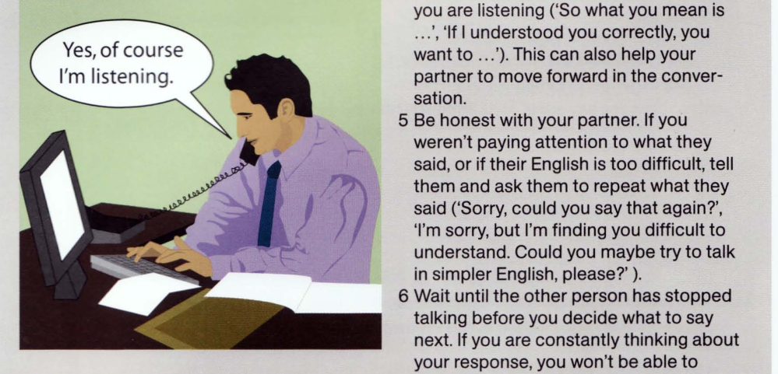

Slide 16
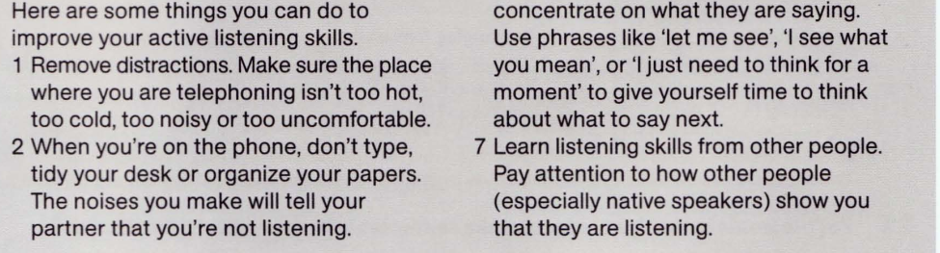
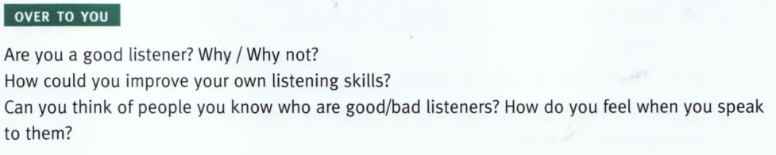

Slide 17
Homework:
After these two periods you have to remember Useful Phrases;
do the crosswords in part 12, and read the article and discuss some questions in OUTPUT.
Prepare for unit 3: Let me get back to you on that

